Slide 1



Talk-driven development
Teaching can be a superpower in software engineering
Vaishnavi V
Software Engineer | Code Wrangler

Slide 2
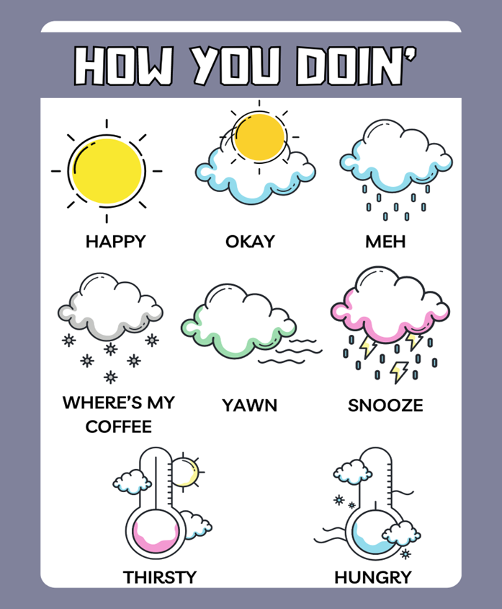
Notes:
Joey Tribbiani from the sitcom Friends

Slide 3
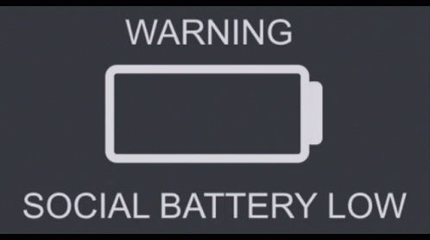
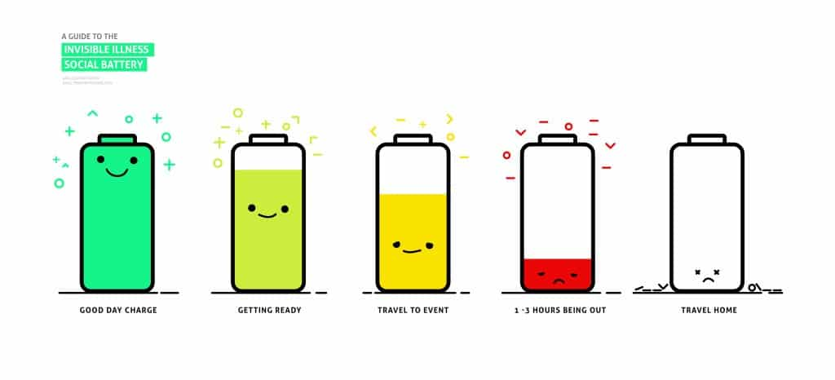

Slide 4


Slide 5
Glossophobia

Slide 6
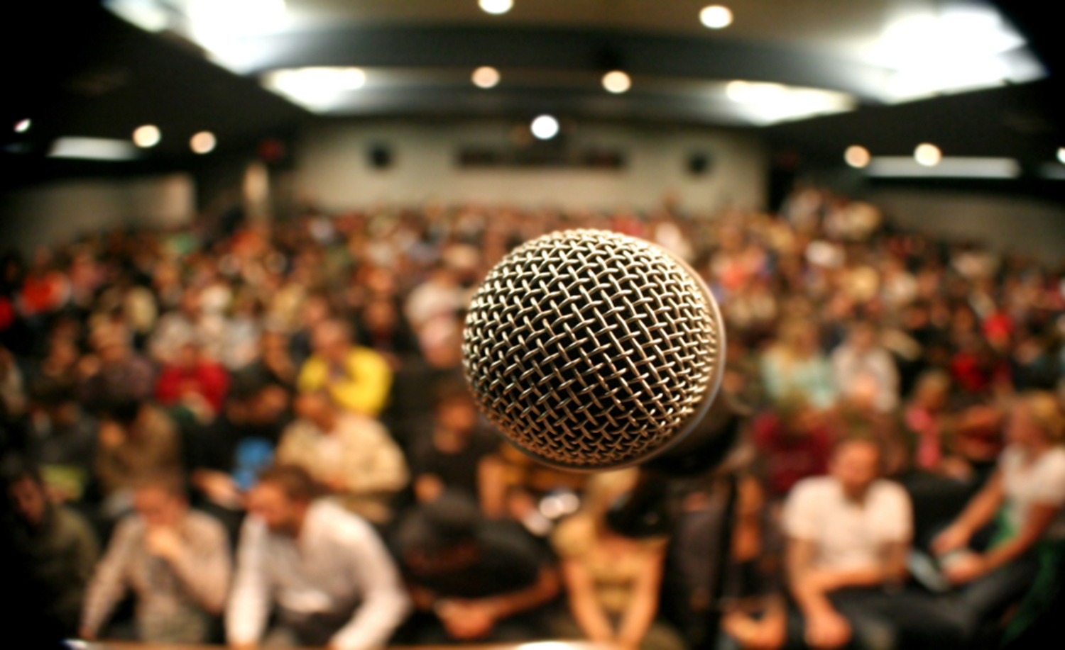

Slide 7
Agenda
Talk Driven Development
Protege Effect
Cascading Mentorship Model
Rubber Duck
SODOTO
Luck Surface Area
Build In Public
Sharing at a sustainable pace
Digital Garden
Concluding Remarks

Slide 8
Talk Driven Development
Committing to speaking on a particular topic can lead to a developer learning something new in the process of experimenting with new technologies in preparation for a presentation
Teaching brings superpowers that span beyond software development

Slide 9


The Protégé Effect
A concept in learning that suggests we learn more effectively by teaching information to others, even if those others aren’t necessarily any less knowledgeable.
Notes:
Copied from brand studio deck with tweaks

Slide 10
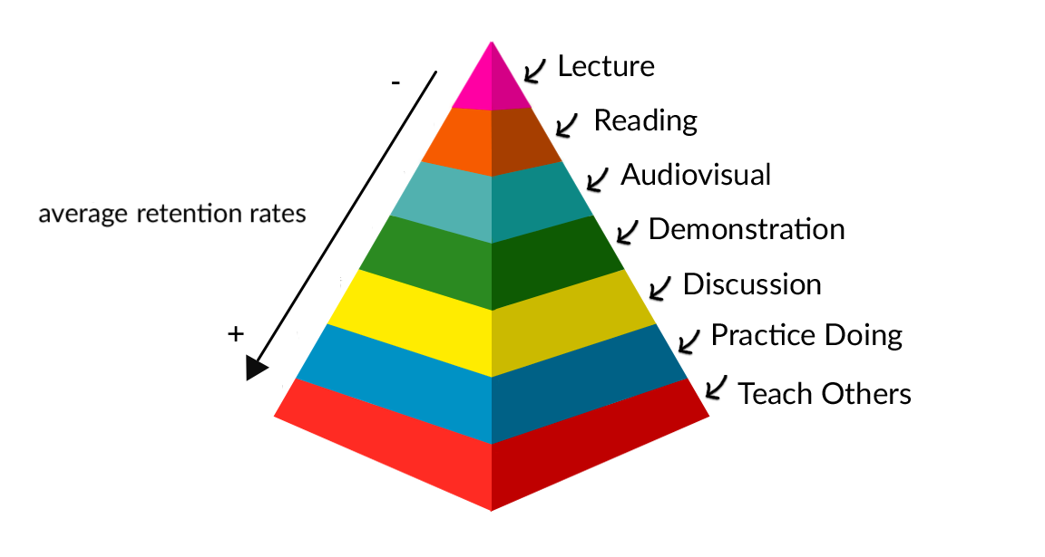

Slide 11
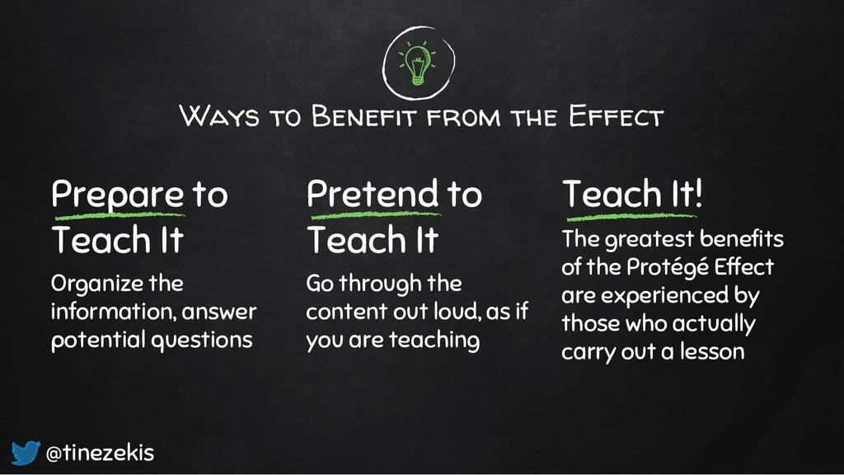

Slide 12


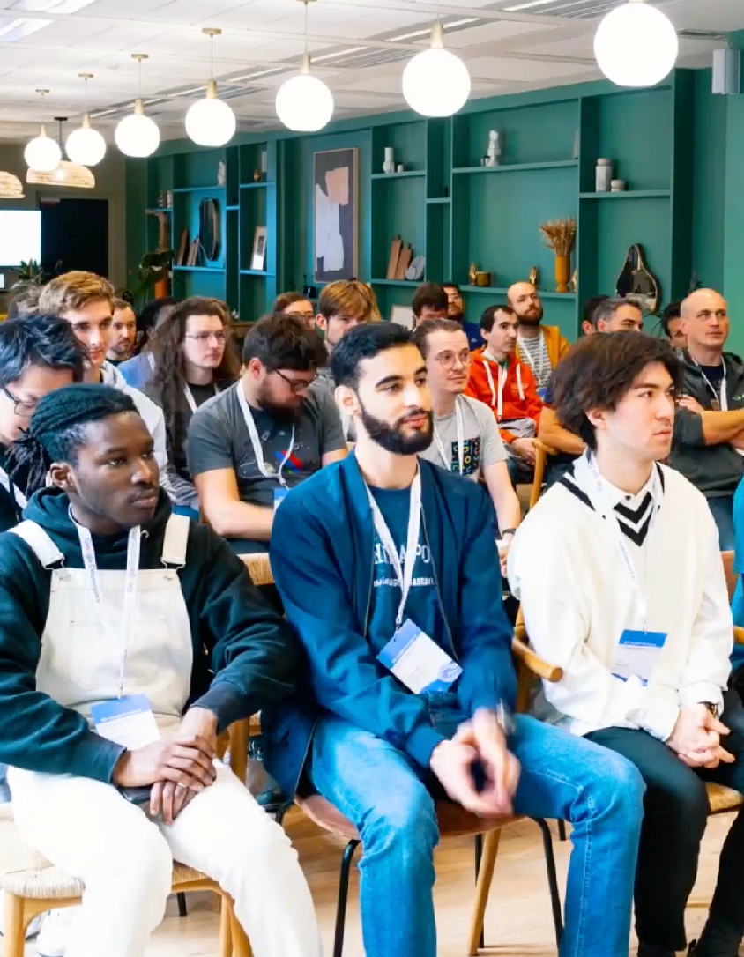

“When one teaches, two learn”
Robert Heinlein

Slide 13
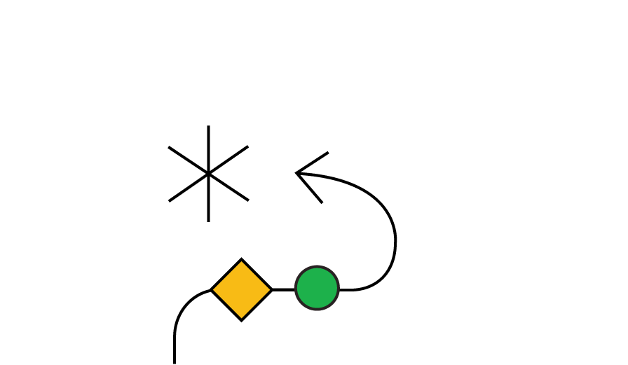

“Teaching isn’t just for the person receiving the lesson. It’s for you too”

Slide 14
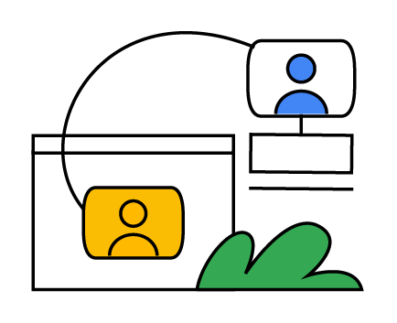
Memory & Cognition study - 2014
Expectation that one will need to teach can enhance one’s learning and organization of knowledge.

Slide 15
“Best times to start teaching something is shortly after learning it”

Slide 16
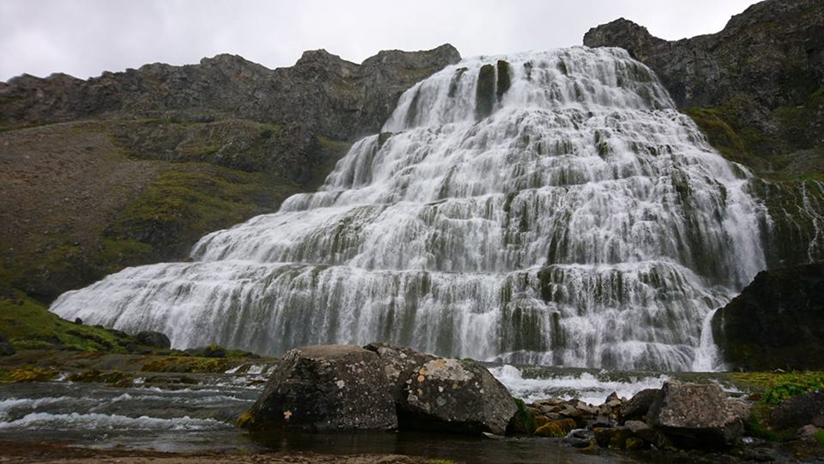

Slide 17
Cascading Mentorship Model
Another form of teaching that utilizes the benefits of the protégé effect, while adding new benefits.
Each student is providing mentorship to someone less experienced than them, and same goes for that person, and so on and so forth

Slide 18
Everyone – even the most junior person – is involved in an active, peer-led exercise that empowers people on every level of experience to understand their own area of practice more deeply.
They are also encouraged to practice their coaching skills, while also analyzing the coaching they receive in order to improve their own skills.

Slide 19


Slide 20
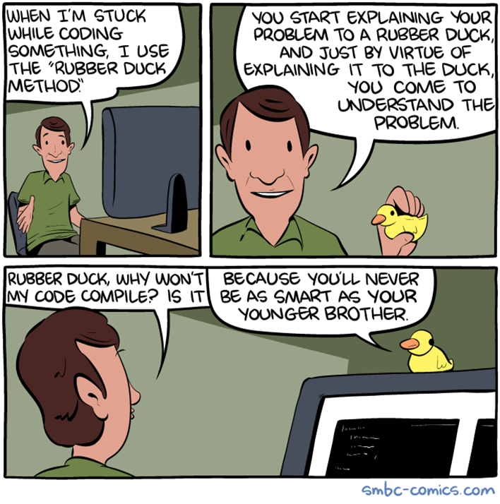

Slide 21
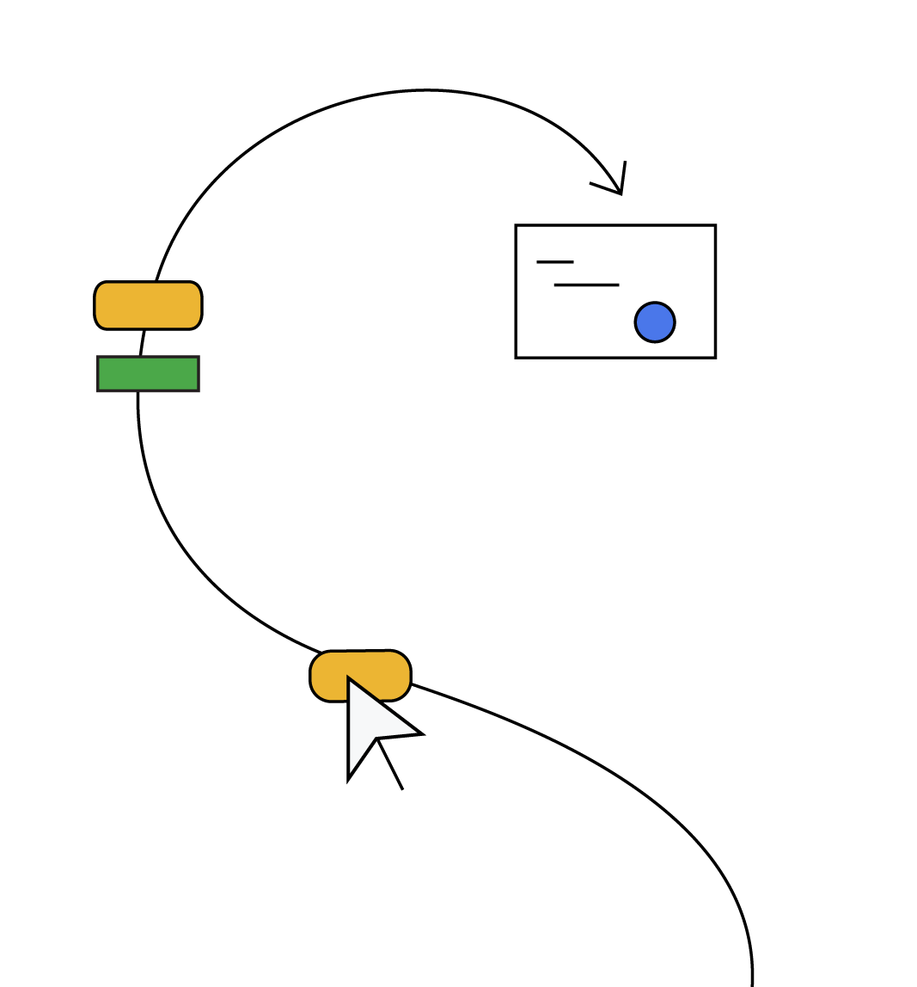
SODOTO
See one — See a procedure and observe how it’s done.
Do one — Do the procedure and practice it.
Teach one — Teach someone else how to do the procedure.

Slide 22


Slide 23
“Publishing your work increases your luck”

Slide 24
How can we increase the odds of finding luck?
Luck is when something unexpected and good happens to you. Unexpected and good. Who doesn’t want to increase the odds of something unexpected and good?
By being a person who works in public. By doing work and being public about it, you build a reputation for yourself.
You build a track record. You build a public body of work that speaks on your behalf better than any resume ever could.

Slide 25
“Luck Surface Area”
— Jason Roberts

Slide 26
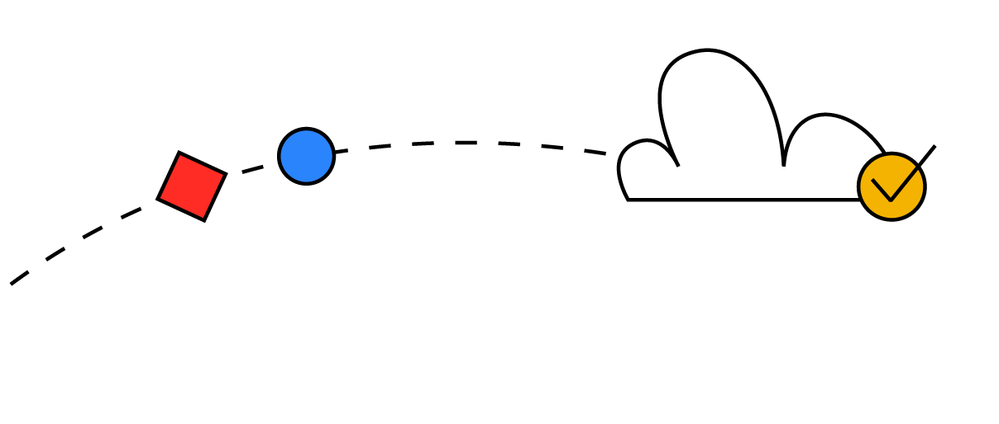
“The amount of serendipity that will occur in your life, your Luck Surface Area, is directly proportional to the degree to which you do something you’re passionate about combined with the total number of people to whom this is effectively communicated.“
Notes:
The word "serendipity" comes from the Persian fairy tale "The Three Princes of Serendip", which was adapted from the poem "Hasht-Bihisht". The term was coined by English author Horace Walpole in 1754 in a letter to his friend Horace Mann. In the letter, Walpole explains an unexpected discovery about a lost painting by Giorgio Vasari, using the fairy tale as an example. The story is about three princes who "always make discoveries, by accidents and sagacity, of things which they were not in quest of"

Slide 27
Start Doing, Amplify with Telling!
The goal is not to become famous, the goal is to increase the chances of luck finding us!

Slide 28
Luck = (Passionate) Doing x (Effective) Telling
The more things you do multiplied by the more people you tell, the larger your Luck Surface Area becomes
The larger your Luck Surface Area, the more likely you are to catch luck as it flows by!
Notes:
Luck = [Doing Things] * [Telling People]

Slide 29
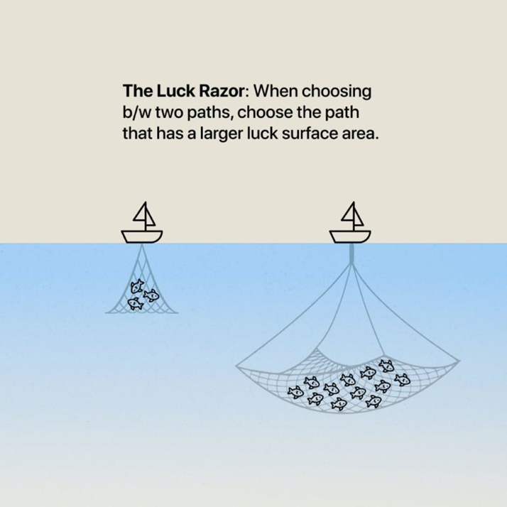

Slide 30
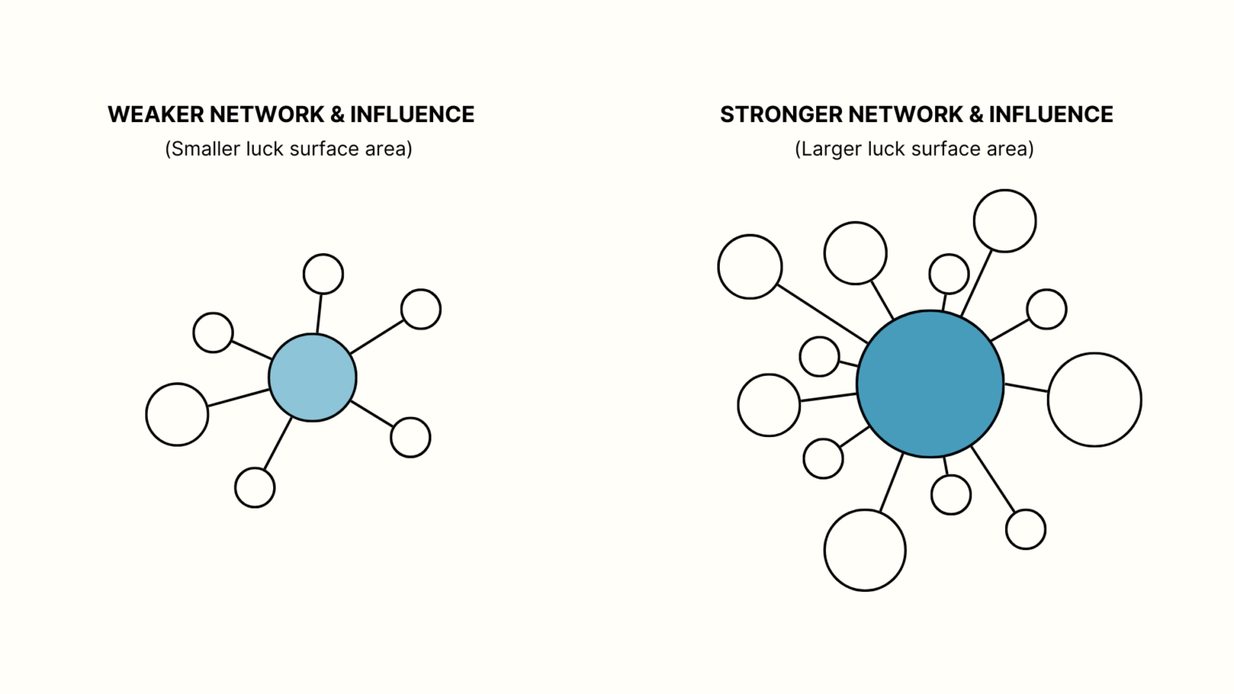
Notes:
Fundamentally, the person with a larger luck surface area is the person who has stronger, deeper, and wider Networks—with significant Influence in those networks.

Slide 31
Which one are you?
You actually are doing things, you’ve just trained yourself to think that anything you do isn’t worth sharing.
You want to be doing things, but you can’t bring yourself to get started.

Slide 32
When people become aware of your expertise, some percentage of them will take action to capture that value, but quite often it will be in a way you would never have predicted.”
The infectious nature of passion, and that taking action and sharing your passion will tend to attract others towards it, again amplified by the number of people who know about it.

Slide 33
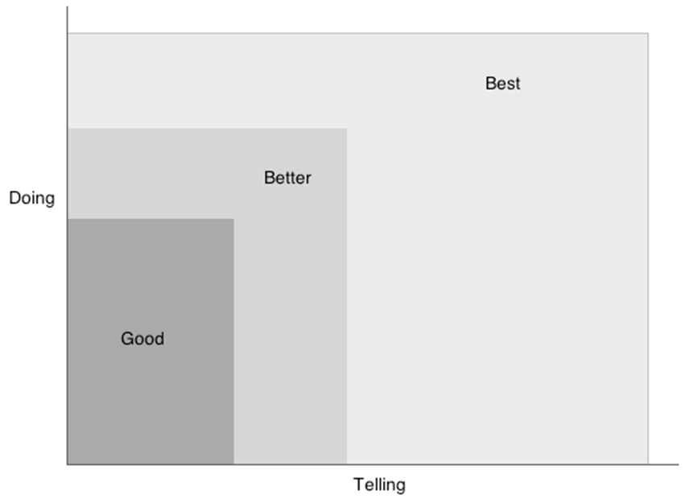
Copyright © 2010 Jason C. Roberts

Slide 34
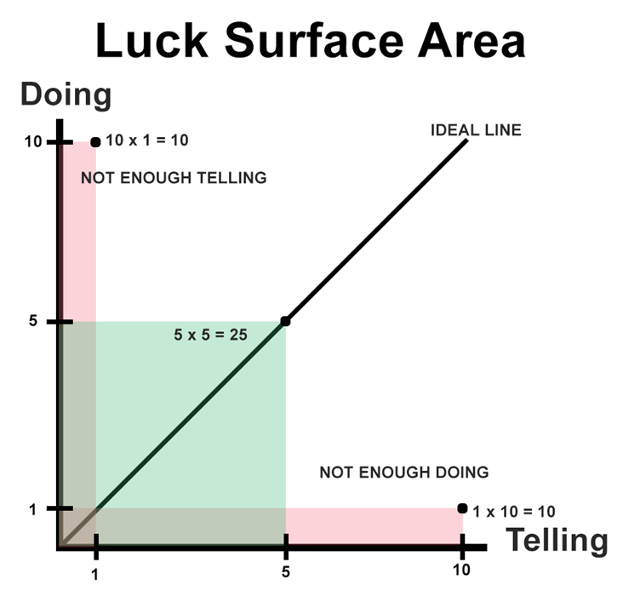

Slide 35
“The law of averages : The relative frequency of an event should correspond to its probability. For example, if the probability of heads in a fair coin toss is 50%, then according to the law of averages, the proportion of heads in a series of tosses should be close to 50%”

Slide 36
Tina Seelig, Stanford professor and the creator of Framestorming, has been studying entrepreneurs and luck for some time
Her reframing of how to view luck aligns well with this model

Slide 37
“Luck is rarely a lightning strike, isolated and dramatic. It’s much more like the wind, blowing constantly. Sometimes it’s calm, and sometimes it blows in gusts. And sometimes it comes from directions that you didn’t even imagine.“
Tina Seelig - Stanford professor and the creator of Framestorming
Notes:
Tina Seelig, Stanford professor and the creator of Framestorming, has been studying entrepreneurs and luck for some time

Slide 38
Whatever you’re excited about, be excited about it publicly.
Blogging, podcasting, commenting in online discussions, and following up with every customer and user, you increase the likelihood of having a serendipitous moment.
It’s a fun concept to consider – but perhaps less of a scientific occurrence than the Law of Averages.

Slide 39
“Engage with people from a place of care and generosity rather than focusing on selling or personal gain. Connecting with the right platforms and communities who might be interested in what you’re doing and are passionate about.”

Slide 40
Share Your Learnings at a Sustainable Pace
Over time, it’s generally more impactful to make small, consistent progress towards an identity-based goal (like being someone who runs regularly) than inconsistently focusing on one huge goal (like running a marathon) - Atomic Habits by James Clear states,
Teaching reveals gaps in our knowledge. When we're aware of those gaps, we become more humble, and we ask more question

Slide 41
Learn the importance of being discoverable by showcasing your work
— Show your work by Austin Kleon

Slide 42
“The person who says he knows what he thinks but cannot express it usually does not know what he thinks.”
— Mortimer Adler

Slide 43
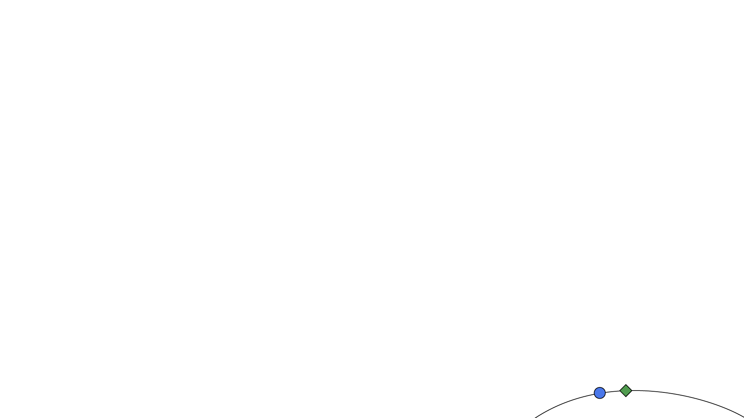
Process, Care, and Craft
Digital gardening : embrace the idea that the process of documenting is more important than the final presentation
Share seeds of thoughts to be cultivated in public
Notes:
A digital garden is an online space at the intersection of a notebook and a blog, where digital gardeners share seeds of thoughts to be cultivated in public.

Slide 44


Slide 45

What’s your superpower?

Slide 46
References
Jason Roberts : https://twitter.com/exojason - Coder, entrepreneur, and podcaster - Luck Surface Area
https://github.com/readme/guides/public-documentation : Monica Powell // Senior Software Engineer, Newsela
https://www.swyx.io/create-luck
https://github.com/readme/guides/publishing-your-work : Aaron Francis // Marketing Engineer, Tuple
https://modelthinkers.com/mental-model/surface-area-of-luck
https://www.skmurphy.com/blog/2019/04/03/increase-your-luck-surface-area-to-get-more-customers/
https://www.linkedin.com/pulse/prot%C3%A9g%C3%A9-effect-why-teaching-someone-else-best-way-learn-simmons/
https://www.growthengineering.co.uk/protege-effect/
https://www.codusoperandi.com/posts/increasing-your-luck-surface-area
https://www.contagiousenthusiasm.com.au/recharge-social-battery/
https://www.brenel.io/blog/luck-surface-area
https://sammatla.com/luck-surface-area/

Slide 47
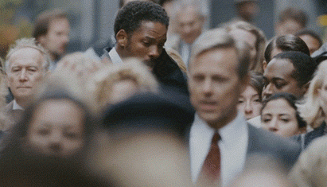
Be healthy both mentally and physically

Slide 48
